Slide 1
Forward stepwise selection for the classification of wine quality:
An exploratory analysis
Thu Vu, Katie McFarlane, Alison King
BIOST 544
December 11, 2022

Slide 2
Introduction
Background:
Vinho verde is a unique variant of wine from the northwestern region of Portugal
Wines are scored on a 10-point scale based on blind taste evaluation from multiple professionals → Stratified into “good” (7+) and “poor” (<7) quality
Problem of Interest: Build a model to classify wines into good or poor quality based on physicochemical predictors
Modeling Approach: Forward stepwise selection (comparing AIC and BIC) to identify statistically significant predictors of wine quality

Slide 3
Dataset Description
The dataset comes from the UC Irvine Machine Learning Repository.
The wine dataset has information on 1599 wines, with 12 variables for each data point
The output variable in this study is a quality score between 0 and 10, dichotomized into “good” or “poor” quality
Potential physicochemical predictors captured in this dataset are:
Fixed acidity (g(tartaric acid)/dm^3), volatile acidity (g(acetic acid)/dm^3), citric acid (g/dm^3), residual sugar (g/dm^3), chlorides (g(sodium chloride)/dm^3), free sulfur dioxide (mg/dm^3), total sulfur dioxide (mg/dm^3), density (g/cm^3), pH, sulphates (g(potassium sulphate)/dm^3), and alcohol (volume %)
Each of the above could reasonably be related to wine quality
There is no missing data for any of the above variables

Slide 4
Statistical Methods
Descriptive Statistics
Stratified by good and poor wine quality (mean & standard deviation)
Training set (70%) & Test set (30%)
Multiple Logistic Regression (training set)
Primary Model
Forward Stepwise Selection with AIC
Sensitivity Analysis
Forward Stepwise Selection with BIC
Wald Tests - statistically significant (if < significance level = 0.05)
Misclassification Error Rate (test set) - compare model performance

Slide 5
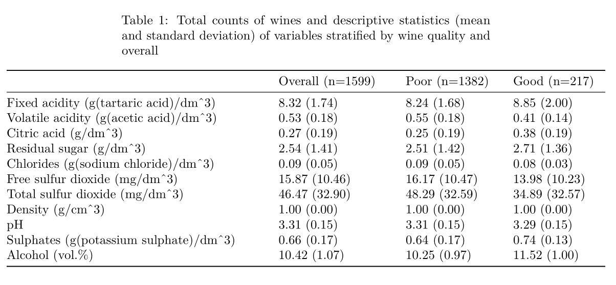
Results
Descriptive Statistics - 13.6% (good quality)
Consistent - chlorides, density, pH
Notable differences in the other variables

Slide 6
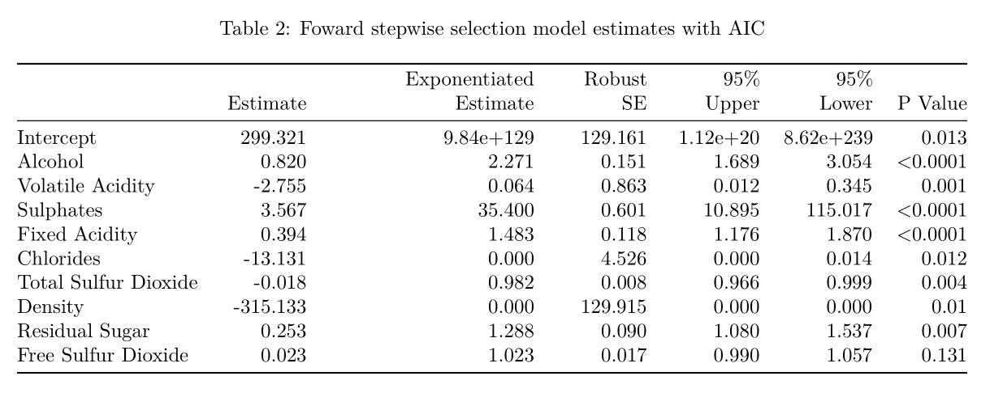
Results
Primary Model
Table illustrates the coefficient estimates, robust standard errors, 95% confidence intervals & p-values
Selected 9 out of the 11 variables
Not Significant - Free Sulfur Dioxide

Slide 7
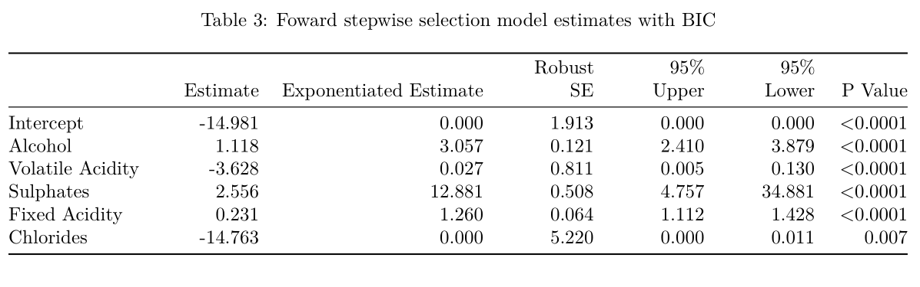
Results
Sensitivity Model
Table illustrates the coefficient estimates, robust standard errors, 95% confidence intervals & p-values
Selected 5 out of the 11 variables
All variables are significant

Slide 8
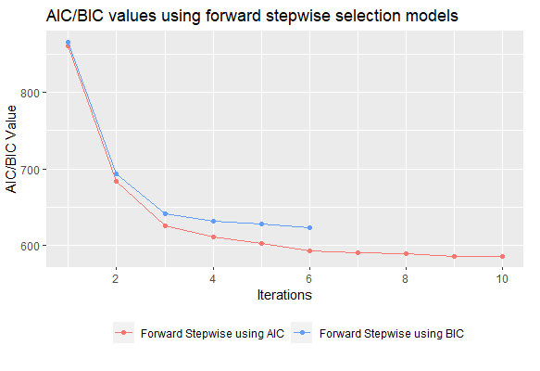
Visualization of Models
The model using AIC includes ten coefficients, and the AIC is reduced to 585.1 after significant predictors are added
The model using BIC includes six coefficients, and the BIC is reduced to 623.2 after significant predictors are added
We can’t directly compare these two criteria, so we’ll look at the error rates

Slide 9
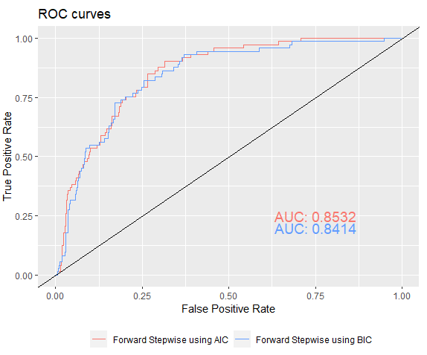
Error Rate
Using the test set, we calculate the misclassification error rate
AIC model: error rate = 0.13
BIC model: error rate = 0.14
The primary model does a slightly better job at classification
The ROC curves (right) are similar and cross multiple times, with a difference in AUC of ~1%

Slide 10
Discussion
Comparison of AIC and BIC:
However, the model with BIC may be more practical for inference as it includes fewer predictors with only a small cost to the misclassification rate (~1%)
Limitations:
Data unbalanced (~86% of wines are classified as “poor”)
Quality scores used to create the outcome are based on subjective human preference

Slide 11
Implications
Predictors in our model are all readily available metrics as part of the wine certification process
Developing a reliable predictive model for wine quality could be valuable for both producers and consumers of wine
Supplement evaluation with a more objective analytical test of quality
Understand the important physical and chemical qualities of a good wine to inform wine-making processes and decisions

Slide 12
References
1. Cortez P, Cerdeira A, Almeida F, Matos T, Reis J. Modeling wine preferences by data mining from physicochemical properties. ScienceDirectt. https://doi.org/10.1016/j.dss.2009.05.016. Published 2009.
2. What are Wine Scores? Wine-Searcher. https://www.wine-searcher.com/wine-scores. Published 2022.
3. Wine Quality Data Set. UCI Machine Learning Repository. https://archive.ics.uci.edu/ml/datasets/wine+quality. Published 2009.

